Slide 1
Derry Talvainn
Walkers
and mountain biking

Slide 2
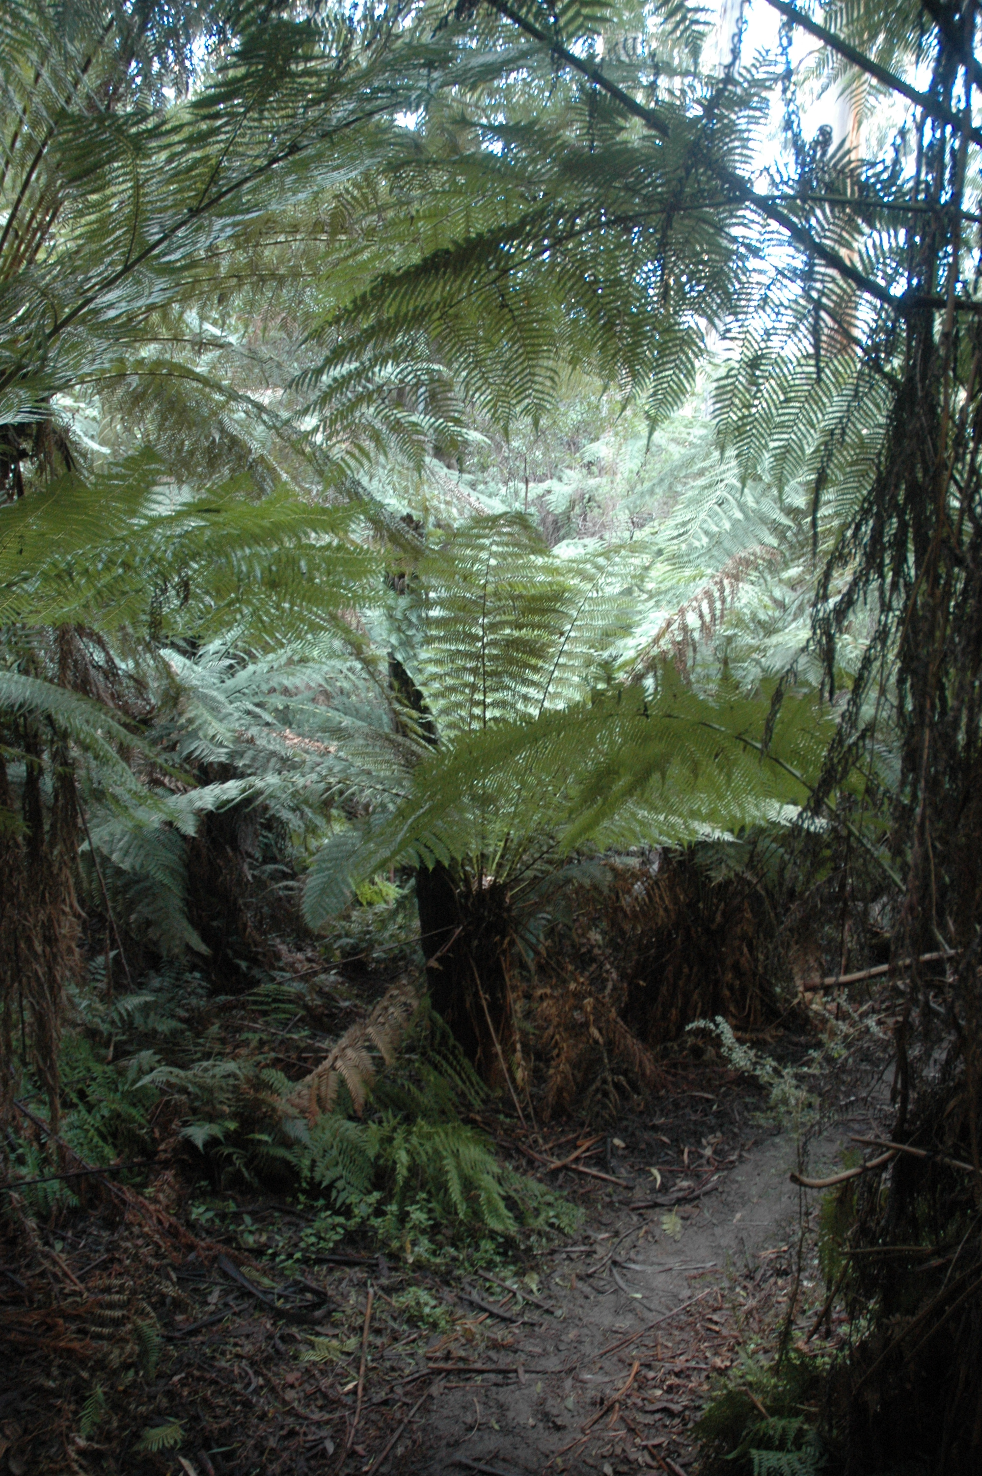
The Backstairs Track
My introduction to mountain bikers was when they started coming down the Backstairs track that I was walking regularly with a friend.
The next slide is a video (click to play) that shows a mountain biker using the Backstairs track. This video demonstrates the danger for walkers. (push the down arrow to exit the video.)

Slide 3
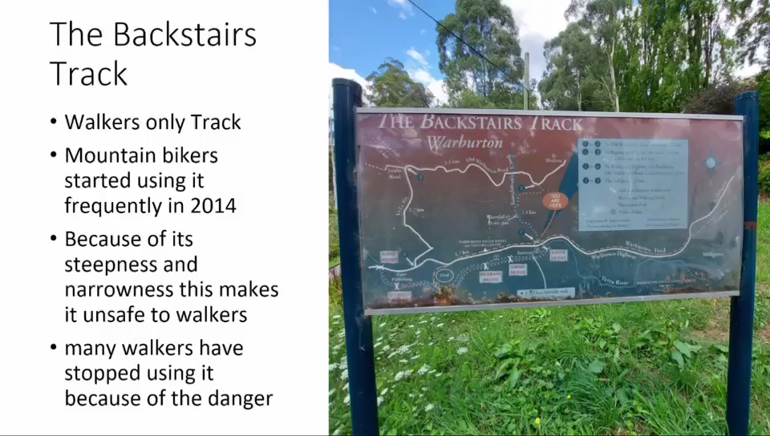

Slide 4
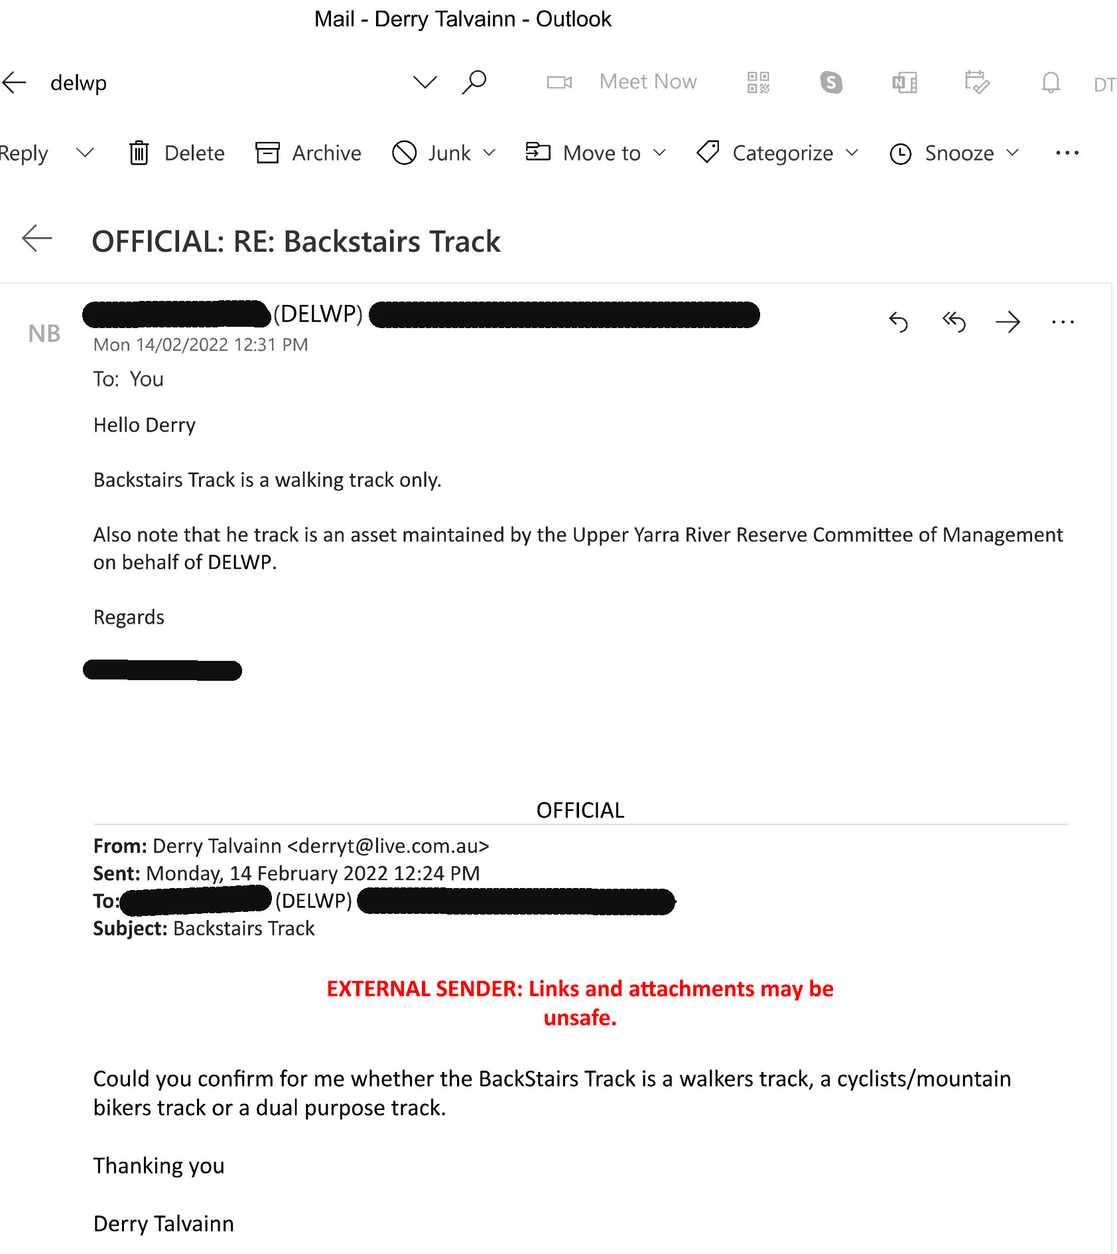
14 February 2022 - This is correspondence with DELWP confirming the Backstairs Track is a Walkers Track only.
I included this recent email as mountain bikers were presenting to the IAC panel that they were no longer behaving poorly but that it was in the past.

Slide 5
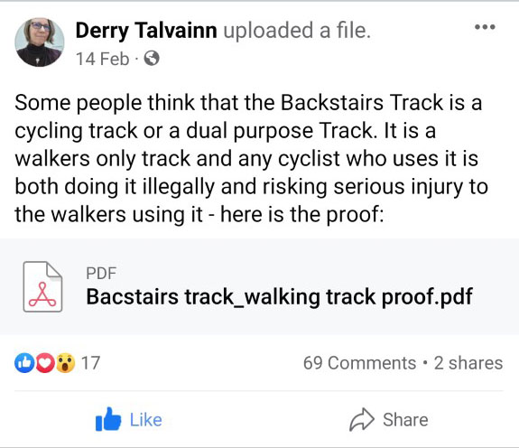
I posted this on a local FB page 14 February 2022. The document attached to the post is the email on the previous slide
69 comments and not one Mountain Biker offered to stop using or to tell other mountain bikers not to use the Backstairs Track.
But I got really heavily spammed! (Including marijuana gummies). Because I inadvertently left my email address in the attachment.

Slide 6
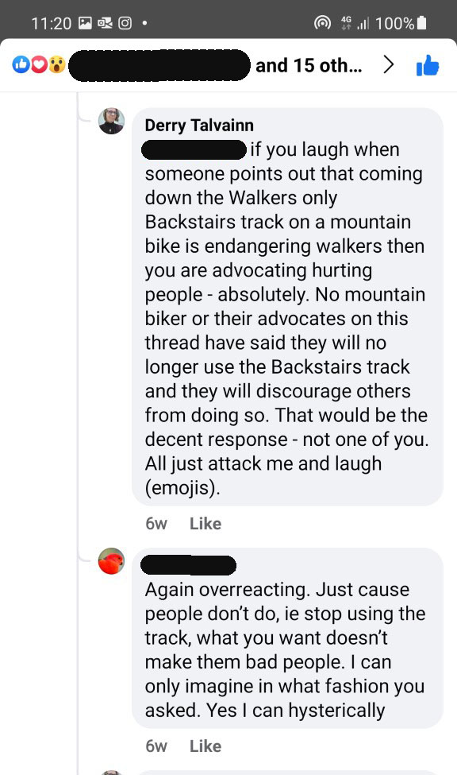
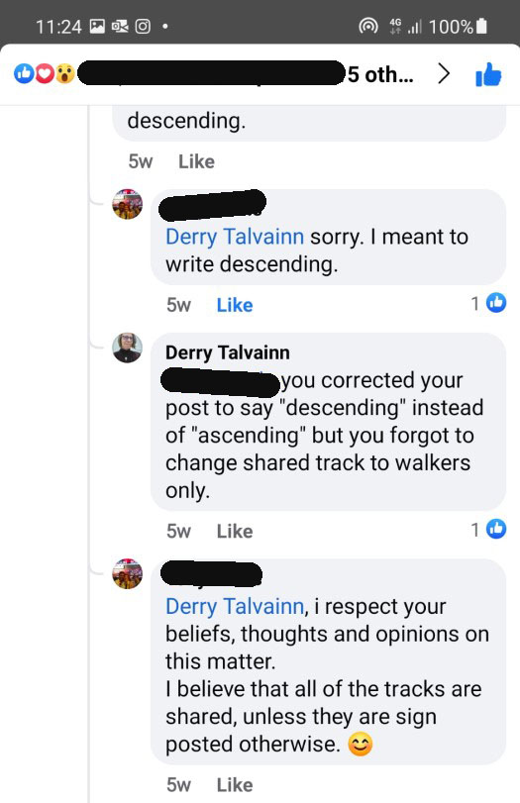
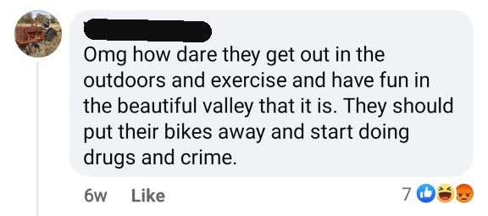
These are some comments on this post.
Left: Mountain bikers are not bad just because they use walker only tracks (and laugh)
Below: Don't stop their fun
Right: Tracks are shared unless they are sign posted otherwise

Slide 7
There was a sign
The sign on the top of the Backstairs track requesting mountain bikers to not come down was destroyed within a few days of its erection.
A solid metal pole holding the sign was bent at a 90 degree angle at its base and the sign was then covered with tree fern fronds to disguise its existence.
Signs requesting mountain bikers not to use trails have been routinely destroyed, defaced or ignored.

Slide 8
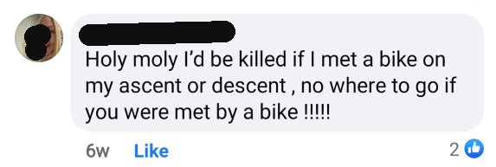
This is a typical response from walkers:

Slide 9
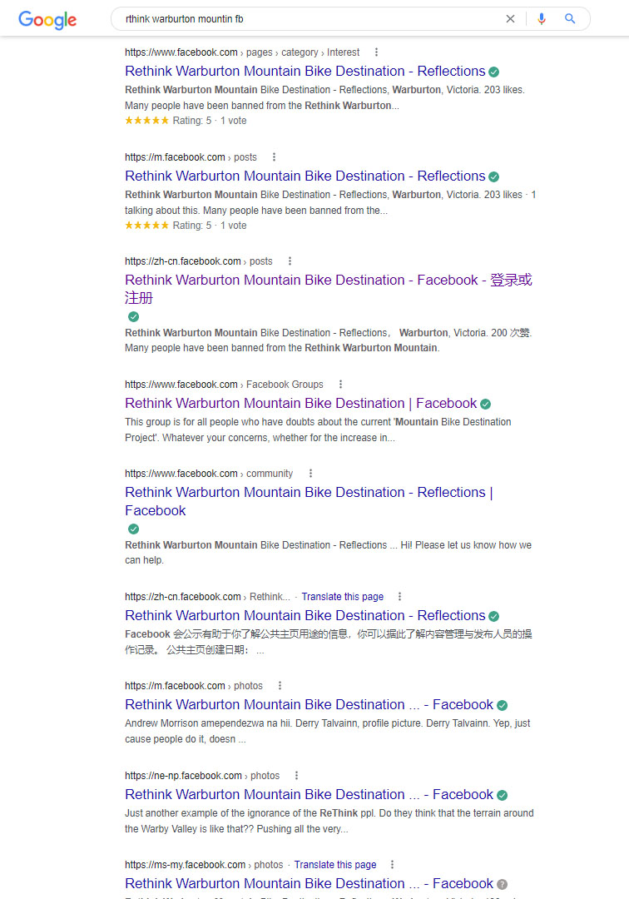
Spamming my email is just one small abuse among the ton of abuse that we have all suffered.
Our Facebook Page was originally open to all but the abuse from mountain bikers meant we were losing members, so we started to weed out firstly abusers and then moles and finally anyone that we didn’t know. Due to abuse we have stayed small to protect members.
One mole hijacked our weakest posts and comments copied pasted and ridiculed them on a fb page called Rethink Warburton Mountain Bike Destination – Reflections. Then made sure that the Reflections stooge fb page would come up multliple times in search with ours only once – as the screen capture on the left demonstrates.
Our main website also had stooge sites made some of which downloaded viruses onto computers that destroyed hard drives. Unfortunately happened to a member.
On public fb pages we were ridiculed and abused routinely. This is how mtbers behave. Far worse than us, their opposition. The EES process has made a few try to be polite to impress the IAC panel.
However, the threats off the internet are worse than the ones on it.

Slide 10
DELWP & Parks started our problems
We had little to no problem with mountain bikers before 2015. It is a misconception that the mountain bike trails are to stop abuse from mountain bikers. The Warburton Mountain Bike Destination is the cause of the mountain biking problems not the cure.
One of the Council Experts at the IAC hearing said they had been having trouble with mountain bikers for at least ten years. It has been at least ten years that the authorities have been helping the local mountain bikers develop their illegal trails (DELWP).
The Warburton Mountain Bike Hub Feasibility Study was released nine years ago
Locals started having a great increase in problems with mountain bikers in 2015, seven years ago.

Slide 11
The DELWP regional manager was quoted in a 2015 news article saying there were no illegal trails on mountain Tugwell:
“DELWP regional manager Nick Ryan said while he was not across the history of reporting, DELWP was currently doing weekend patrols which were not detecting illegal track building.
He said there was a misconception that it was illegal to ride in the state forest, but it was the building of tracks and jumps that was illegal.
“If we find people digging tracks we will book them,” he said.”
Quote from Mountain Views Newspaper article “Uphill task for all users” 30/11/2015
However, DELWP had been facilitating illegal or to use their word “informal” mountain bike trails construction on Mt Tugwell since earlier than that as posted by the YRMTB on Facebook and in a newspaper article dated earlier.

Slide 12
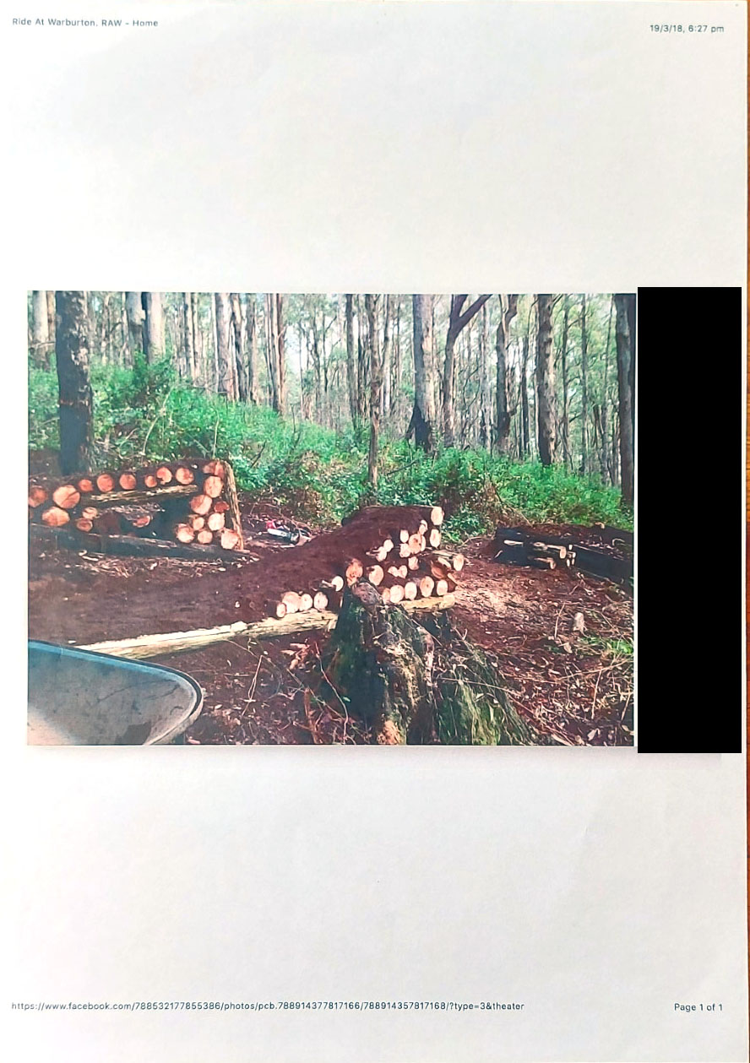
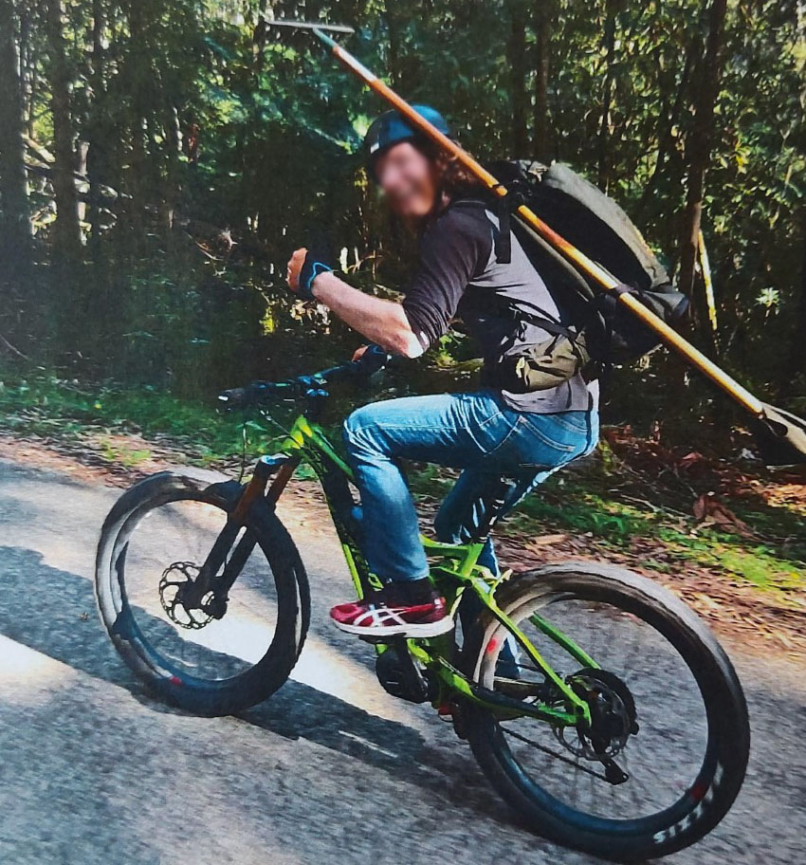
Taking tools up to work on trails

Slide 13
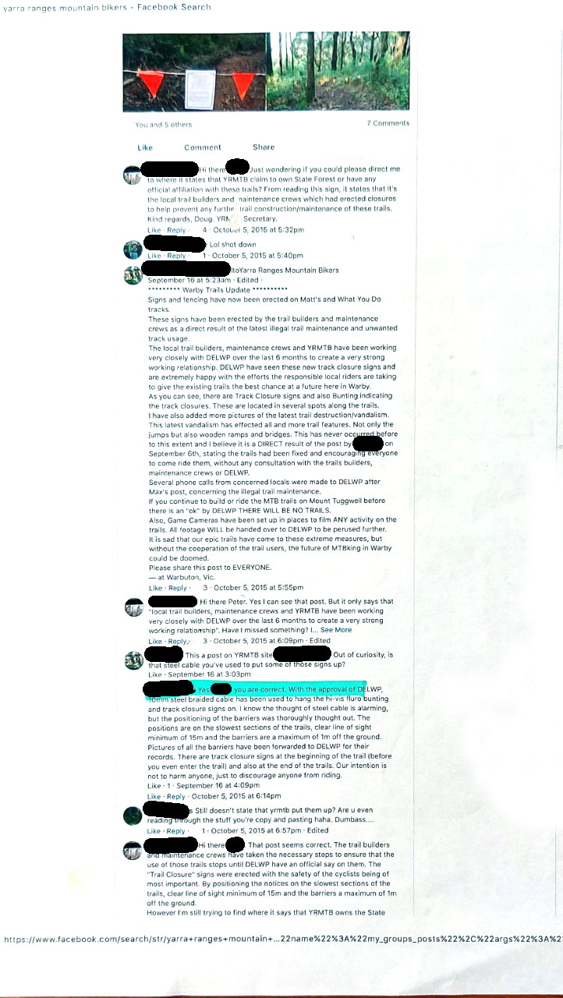
Facebook Posts on YRMTB page: Working very closely with DELWP for 6 months on tracks dated October 2015
Trail building working bee.

Slide 14
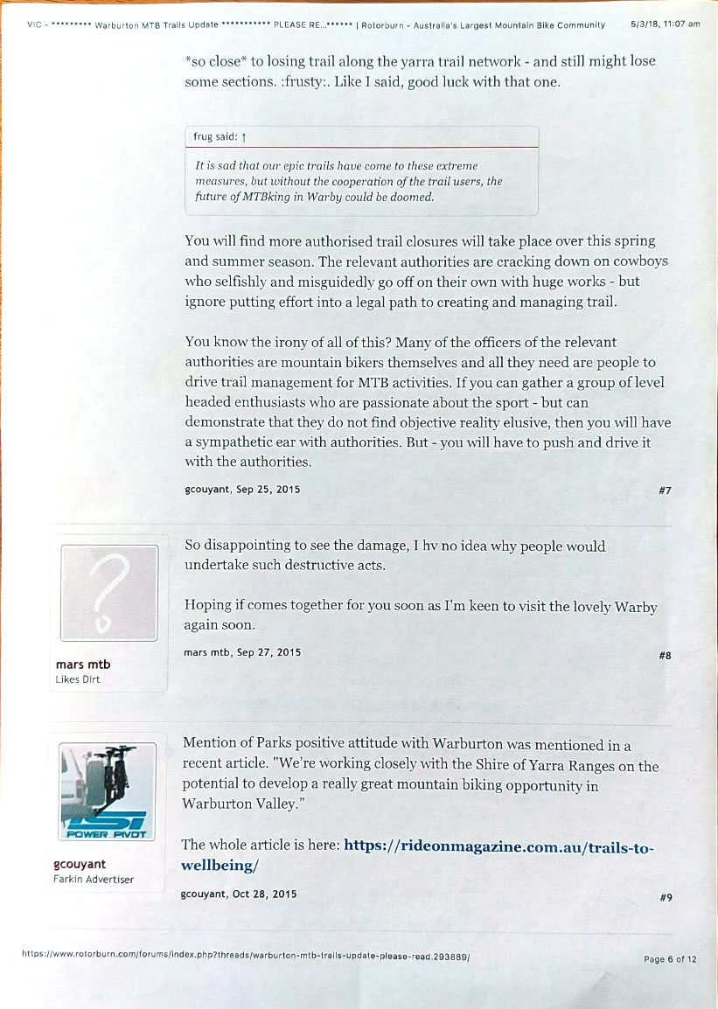
Here the mtbers differentiate between tracks that are to be closed down and trails that DELWP considers are legal to work on. However, the DELWP regional manager said that ALL trail building is illegal.
Notice that it also says that many of the relevant authorities are mountain bikers. Bias.

Slide 15
Trails to wellbeing – Ride On Bike Magazine (explaining the extent of DELWP and Parks involvement)
Posted on 19 October, 2015 by admin https://rideonmagazine.com.au/trails-to-wellbeing/
Across the country, land managers are building bike trails to increase the use of parks and public land. Simon Vincett reports.
“ . . . informal trails, built furtively by enthusiasts, are being recognised and often embraced by land managers, who wish to encourage recreational activity in their parks.”
Luke Chiu of trail building company, Dirt Art, reports that a solid proportion of their business is enhancing popular guerilla-­built trails which councils and land managers have come to realize can’t be closed down. The process is to make the trails sustainable, with good drainage and stable construction. Dirt Art have been commissioned to formalise such trails all over Australia, from Tewantin National Park in Noosa to council reserves in Tasmania.
“Parks Victoria has been actively involved in mountain biking for a long time,” Hardman points out. “We have dedicated mountain biking facilities at Lysterfield Park and the You Yangs and we partnered with other government departments to develop another mountain bike facility in Forrest. We’re working closely with the Shire of Yarra Ranges on the potential to develop a really great mountain biking opportunity in Warburton Valley.”
“We’re really keen to work with local communities to build sustainable trails,” Hardman says. “We’ve recently established a collection of trails in partnership with the Red Hill Riders at Arthurs Seat on the Mornington Peninsula. We’re working very closely with local groups to formalise trails through a number of parks in the metropolitan area: such as the great single-track along the Yarra River and in the Dandenongs around Silvan.”

Slide 16
“So in partnership with the Department of the Environment, Land and Water, we have developed a procedure that can step people through a process that will enable the formalization of trails where appropriate, but it also helps to decide the cases in which it’s just not appropriate to have trails in these areas.”
This is it. This is the program to spread mountain bike trails everywhere. Pretending it is grass roots driven and pretending that it will not adversely impact other users of the bush or our reserves, pretending that this little 1.6% demographic is huge and going to grow illegally if it is not pandered to.
Remember, we didn’t have trouble with mountain bikers until after DELWP and Parks Vic got involved.
Some mountain bikers approached DELWP about formalizing a few trails on Mt. Tugwell and instead they get offered the Mountain Bike Capital of Australia.
The process is being applied over and over again all over Australia and the pretense is it is grass roots driven. It is not. It is the response to the Federal Government releasing funding to develop Australia as an Adventure tourism capital. And mountain biking is on the top of the list.
At the expense of local residents and other gentler sports. Any other recreational user of the bush and anyone unfortunate enough to live in an area with tourism potential who is not into mountain biking.

Slide 17
Is this enough proof that the regional manager was either lying or was seriously misled by his own department?
Want more on the suppression of opposition?
https://rethink-warburton-mountain-bike-destination.com/issues/lack-of-consultation/

Slide 18
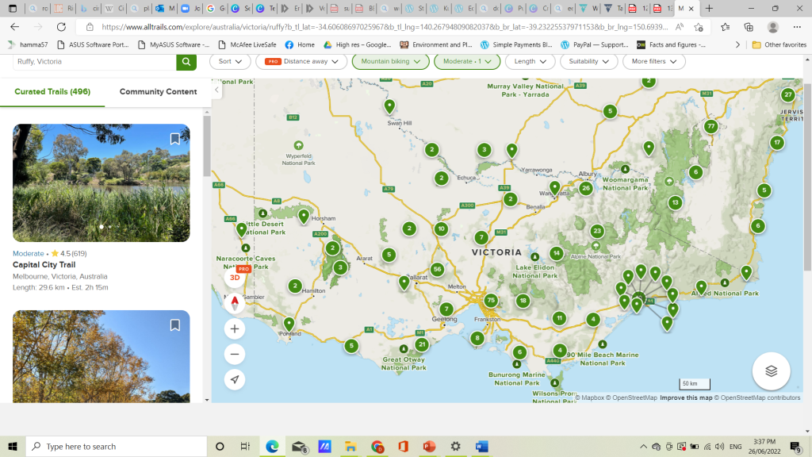
Mountain Bike Trails in Victoria
Please note: Each Green marker indicates mountain bike trail destinations, the number inside the marker indicates how many of them. In Victoria there are 329 already.

Slide 19
Stereotyping Mountain Bikers?
In a 2015 Public Meeting to resolve problems between mountain bikers and walkers things turned abusive.
(Description of physical threats by mountain bikers given to the IAC panel)

Slide 20
Mountain Bikers:
buzz walkers - on their bikes and in cars
abuse walkers out car windows
told activators not to be caught out on the mountains alone
physically threaten and intimidate activators
incited others to rob an activator's home
destroy walking tracks by taking them over and building infrastructure on them
threatened to burn a house down
sneer and laugh at our concerns

Slide 21
Not all mountain bikers - but enough
Derby residents also complain of illegal activity and abuse, as do other mountain bike areas we are in contact with.
Even mountain bikers complain on their forums about the "cowboy" and "d*head" element that breaks rules. Some of the worst are middle aged men that are treated like upstanding citizens with businesses or good jobs, married and with children.
(I have a lot of this documented: newspaper clippings, council minutes (derby), screen captures of conversations, photos, letters, personal communications.)

Slide 22
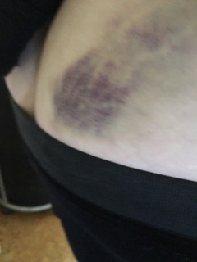
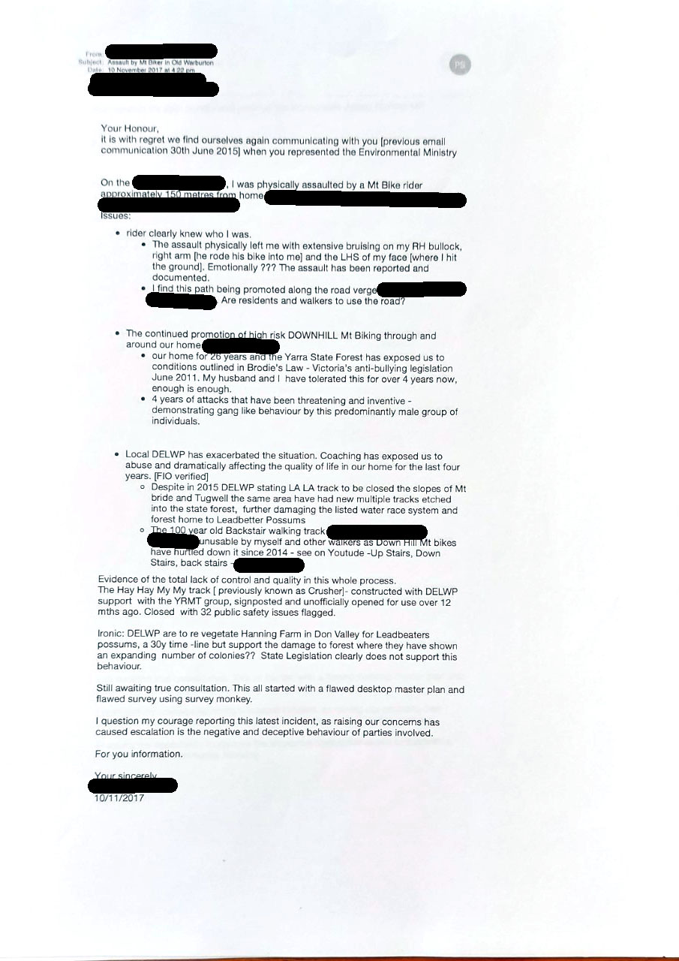
This bruising was caused by a mountain biker deliberately running over a walker when out walking. He called her a b**ch beforehand.
She did not know who he was.
Quoting a letter she wrote to authorities:
". . . I was physically assaulted by a Mt Bike rider approximately 150 metres from home.
[the]rider clearly knew who I was
the assault physically left me with extensive bruising on my RH buttock , right arm (he rode his bike into me) and the LHS of my face (where I hit the ground). Emotionally ???
The assault has been reported and documented . . ."

Slide 23
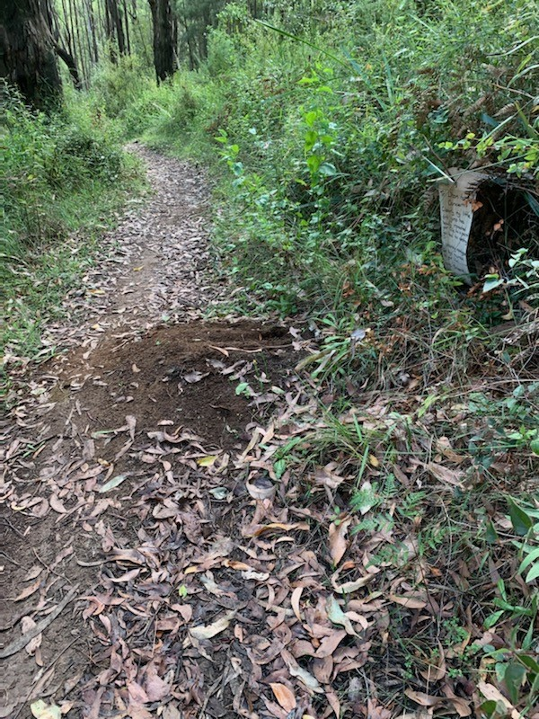
The trail where the attack happened. It used to be a walking trail but not only do mountain bikers use it but they also use it for the Gravel Giro della Donna.
Although all proposed mountain bike trails will be mountain bike only – most walking trails will now be shared trails with mountain bikers.
The only exception are two very steep tracks that are too dangerous for walkers to use because mountain bikers are using it and are uninterested in rules. DELWP has been unsuccessful at keeping mountain bikers off these tracks and they will continue to be unsuccessful now that they have brought the mountain bikers here with a promise of the mountain bike capital of Australia. Making new trails has not proved to stop mountain bikers from using alternative trails as experienced at Blue Derby Tasmania.

Slide 24
A report from California State Parks
"The mischaracterization that there is no evidence of negative contacts between equestrians and bikers is entirely consistent with a pattern of lobbying by biker groups whereby bikers claim there are few or no negative contacts between user groups."
“We discovered that the picture of successful trail sharing that had been presented to the Department by mountain biking advocates during the six-year advocacy process that preceded open discussion was not supported by the record. On the contrary, throughout the United States, a pattern of conflict and abuses on shared-use trails has emerged wherever there is population density. These include displacement, conflict, injuries, deaths, liability, and environmental degradation."
“In the U.S. and Canada, recreation districts formerly supportive of mountain biking have closed trails and are in the process of closing trails previously opened to mechanized use. After years of investing recreational dollars, staff time and law enforcement resources into the shared-use effort, they have found that shared use involving mountain biking is unsustainable. This trend is accelerating."
Final Program Environmental Impact Report for the Road and Trail Change-in-Use Eval SCH No. 2010092023, California State Parks, 2012
[This document provides a wealth of other information about trail degradation problems and the dangerous conditions created by combining fast-moving, speeding mountain bikes (and E-bikes) with other slow-moving trail users (hikers, seniors, families with children, equestrians, nature lovers, runners, dog walkers, etc.)]

Slide 25
Just in case you missed that:
“We discovered that the picture of successful trail sharing that had been presented to the Department by mountain biking advocates during the six-year advocacy process that preceded open discussion was not supported by the record. On the contrary, throughout the United States, a pattern of conflict and abuses on shared-use trails has emerged wherever there is population density. These include displacement, conflict, injuries, deaths, liability, and environmental degradation."

Slide 26
Mountain biking is an extreme sport
The definition of extreme sport is a sport that risks serious injury.
Within mountain bike circles is a subculture of macho toughness. Avid mountain bikers boast about their injuries.
The Shire of Yarra Ranges held a course called "Modelling Respect and Equity in the Shire of Yarra Ranges". In the course it was emphasised through statistics that it is the macho, tough guy image that is most likely to commit violence against women.
Many studies have shown that macho sports are connected to increased violence against women. This is our experience also.

Slide 27
Secondary Abuse
Secondary abuse happens when victims speak about their experience.
They are often treated as though they are lying or exaggerating. They are accused of being hysterical.
It often results in a strong defense of the accused or the accused demographic.
Many victims of abuse count the secondary abuse as worse than the primary abuse. It silences them and prevents them from getting support.
The #metoo and #LetHerSpeak movements have brought attention to this silencing.
(Note: and after this presentation was delivered to the IAC Panel there was an avalanche of it behaving just as predicted!).

Slide 28
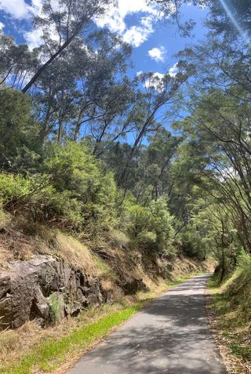
Shared Paths
The 177kms of trails in the Project are for mountain bikers only.
Most other trails are shared paths.
The RailTrail, our most popular trail, will have an ascending mountain bike trail coming directly from it with a descending trail connecting to it also. The proposed bridge for mountain bikers over the Warburton Highway also connects to it.
Cycling tourists who are a good mix of males, females and families love this trail. Unlike mtbers who are 90% male.
Even so it is decreasingly patronised by walkers because of the bike traffic on tourist days. Horse riders have alsolargely abandoned it because bikes spook horses.
During the pandemic 5km restrictions, traffic on the RailTrail soared by 49% while bike traffic dived by 52% - because locals prefer to walk.
The busy bike traffic is particularly difficult for mums walking with young children, the elderly and dog walkers.

Slide 29
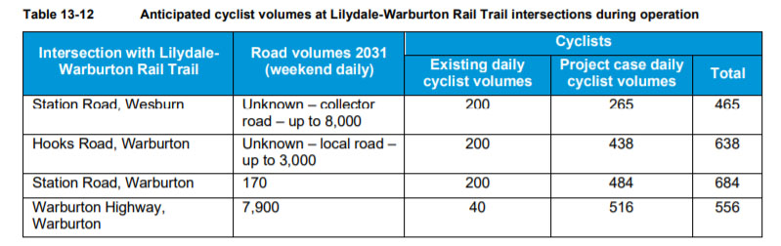
The Project is predicting in their Traffic Report that cyclist traffic on the RailTrail will increase more than three-fold. This will reduce walking even more and may also deter the usual tourist cyclists who will be heavily outnumbered by mountain bikers and may find that uncomfortable.

Slide 30
The Warburton Mountain Bike Destination Project is supported by Parks Victoria under their Program:
Healthy Parks, Healthy People
One of the five objectives of the project is to:
Enhance the health and wellbeing of the community
My first reaction to this was that it was making walkers less healthy
. . .but there are more reasons that this objective will not be met.

Slide 31
More Claims
It is also claimed the economic benefits of the project includes:
Indirect health benefits for Victorian users estimated at $47.1 million over 10 years
with social benefits including:
Enhanced community access to infrastructure that encourages increased levels of physical activity as well as health and wellbeing outcomes
Not for Walkers

Slide 32
The Project claims it will also:
Assist in addressing high levels of obesity, dementia and poor mental health that are significant issues for the community
It won’t

Slide 33
To prove the health benefits of mountain biking they used the inappropriate studies
The two studies relied on by the Council to assess the health and economic benefits of the project were not based on mountain biking, they were based predominantly on walking:
Active Impacts: the economic impacts of active recreation in Victoria by Marsden Jacobs had:
- no mountain biking. It was based on 37% walkers and if you add bushwalking, hiking and running that is 53% of the sample. The next biggest was swimming followed by gym.
      Evaluating the health benefits of Active Transport modes by Genter, Donovan, Petrenas and Badland (2008) New Zealand Transport Agency research report 359, Wellington had:
- No mountain biking. 80% walkers and 20% cyclists
Neither of these studies are appropriate to assess the health and economic benefits of mountain biking because they are not about mountain biking at all.

Slide 34
The Project even used the accident rates in the Marsden Jacobs study to claim mountain biking had a low injury rate, when the reason the study had a low injury rate was because walking has an extremely low injury rate – not mountain biking.
No extreme or team sports were used in this study – mountain biking is an extreme sport

Slide 35
Mountain Biking is not Active Transport
        “Active Transport relates to a physical activity that is undertaken as a means of transport. It includes transport by foot, bicycle and other means of non motorized vehicles . . . Active Transport does not include recreation by walking, cycling or other physical activity that is undertaken for recreation”
        Be active Australia: A framework for health sector action for physical activity 2005-2010. DHS
        It is not mountain biking which is purely recreational and mostly relies on transport to and from mountain bike trails and often requires shuttling by motorized vehicle up and down a mountain
        Active Transport is supposed to decrease the use of motorized vehicles not increase it

Slide 36
And yet the funding for Active Transport is being used for mountain biking
“The Victorian Cycling Strategy 2018-2028 sets out a number of initiatives to increase the number, frequency and diversity of people cycling for transport . . .
. . . We are working on improving roads for walking and cycling in regional Victoria spending $3 million for the Warburton Mountain Bike Destination and one million on the proposed 112km Omeo mountain bike trail.”
https://transport.vic.gov/getting-around/walking-and-cycling
Can you improve roads for walking and cycling by building mountain bike trails? Short answer?
No.

Slide 37
And another . . .
“Cycling investments of $1 million dollars towards the development of Harcourt Mountain Bike Park.”
Updating Victoria’s cycling strategy, Victoria State Government, 2015
This money was allocated form the TAC safer cyclists and pedestrians fund (an Active Transport fund)
Safer pedestrians? Safer cyclists?
Active Transport funds are for decreasing motorized vehicle use while giving opportunities to have healthy exercise while travelling to destinations like work, shopping, going to school or visiting friends.
So are Active Transport funds being used for mountain biking because there are ample funds for Active Transport?
Short Answer?
No.

Slide 38
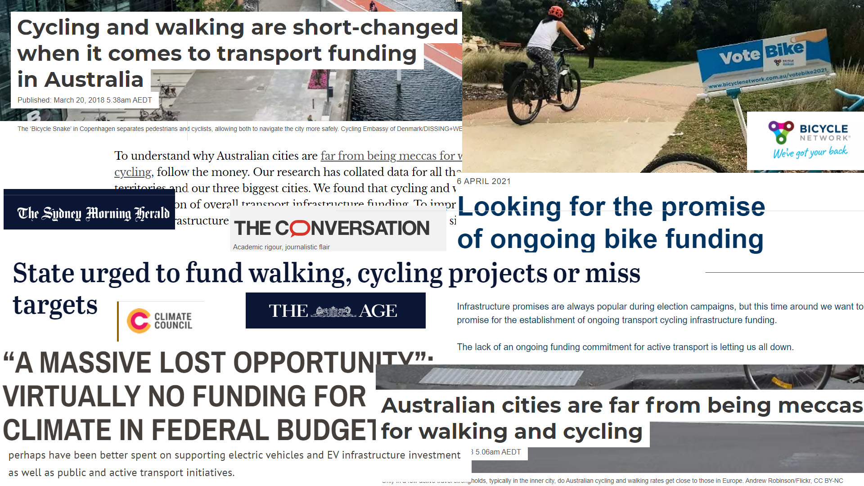

Slide 39
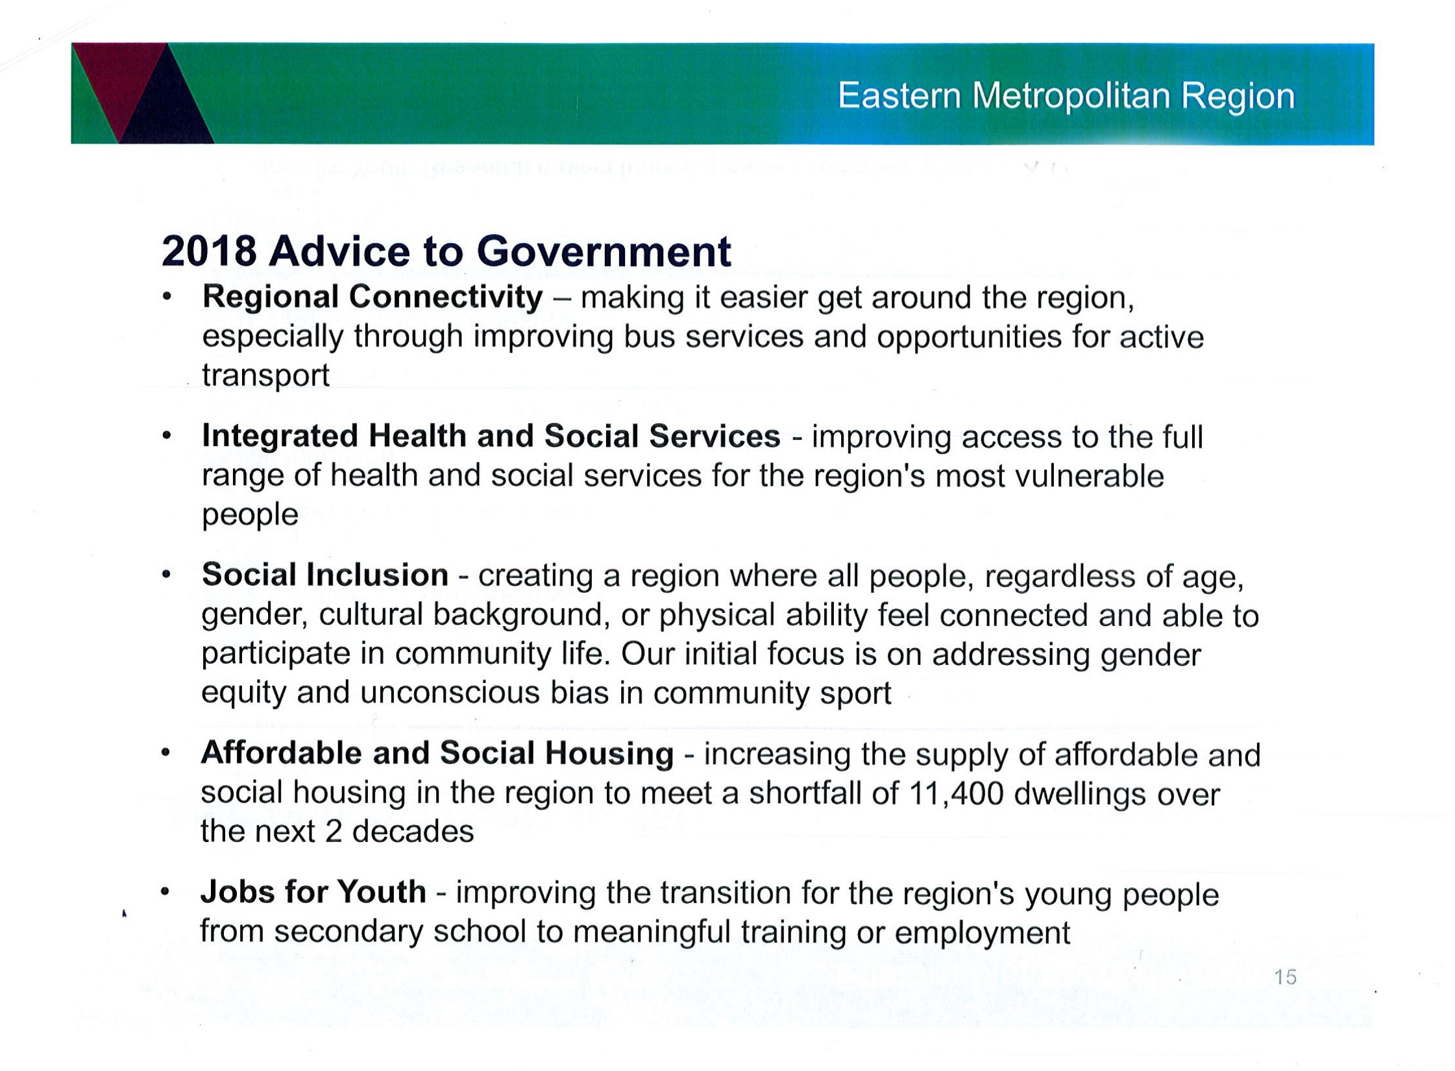
Eastern Metropolitan Region also gave funds to the Warburton Mountain Bike Destination. This is their advice to government.
Will it improve active transport? NO
Will it improve services to the region’s most vulnerable when it will be forcing them out? NO
Will it really address gender equity in sport? NO
Will it help with housing? NO
Will it help with our local unemployment? NO
No to all

Slide 40
Vulnerable Demographics
The Marsden Jacobs Report used by the Council also states:
“We also know that the physical activity of Victorians and Australian generally declines with age, and that females of all ages generally have lower physical activity rates than males.” (VicHealth 2016)
Mountain biking is a male dominated sport and is rarely taken up by people over 50 years of age.
What is really needed is to help these demographics increase their physical activity, as encouraged in the above report. A mountain bike destination will not achieve this. The opposite – it will and bikes already are, decreasing physical activity for walkers.

Slide 41
And who is this for?
Mountain bikers:
1.6% of the population
(Auscycling 2021 statistic)
1.4% of the population
(Roy Morgan 2021 statistic)
It is not a popular sport despite all the spruiking

Slide 42
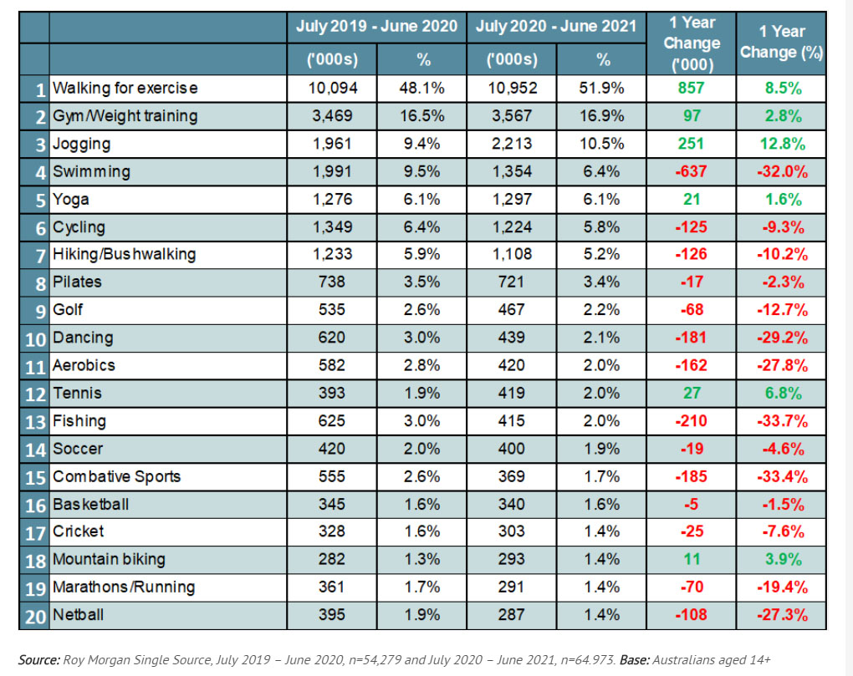
Roy Morgan Top 20 Sports 2019 and 2021
No. 1
Walking for exercise 51.9%
No. 6
Cycling 6.4%
No. 7
Bushwalking 5.2%
No 9
Golf 2.6%
No 18
Mountain Biking 1.4%

Slide 43
And these four other sports are the ones you will damage by building the mountain bike destination.
Bushwalkers are already being run off their trails by mountain bikers who do not care about signage or advice about walking only trails from DELWP – they will not listen to you if you tell them not to. An increase in Mtb tourism will make it worse. The real problem with mountain bikers only started in 2014/5 AFTER the release of the Mountain Bike Feasibility Study and worse after newspaper articles about the plans.
Walkers on the RailTrail and around the river walk are already suffering due to excess traffic and are avoiding the trails either altogether or at peak tourist times. Dog walkers, the elderly, women with children and horseriders are the most vocal about the lack of amenity on the RailTrail right now. Do you care?
Cyclists – there is a prediction that traffic of bikes on the Warburton Millgrove section of the trails will more than triple. This extra traffic will be mountain bikes that have trails that ascend from descend to the trails. Do you seriously think that Mrs Mum and Mr Dad with their kids or the elderly out for a gentle ride are going to enjoy what is already an overstretched facility if it is dominated by male mountain bikers between the ages of 30 and 50?
Horse and Pony Clubs – horses spook when mountain bikes flash past and yet you think you can control that? You can’t. And there are little kids on those horses. Where is your duty of care?
Off Leash Dog Park – dogs spook too, sometimes that means they chase and attack bikes and sometimes that means they will run away and hide and yet you are taking a third of their space for parking and they will have mtbers all around them
Golf – Do you really think that Golfers will not be negatively impacted by being the Mountain Bike Hub in Warburton with a mountain bike trail through the entire length of the course?

Slide 44
Gender Impact

Slide 45
Mountain Biking is male dominated:
Auscycling survey 80%
YRMTB 85%
TrailForks data 94%
EES submissions in support 90%
In the Auscycling survey by GHD Advisory the MTB Club female participation statistics:
28% of the females were
between the Age of 0-9 years of age
Remove this group and the statistics are 87% male

Slide 46
Recreations opposed to the Warburton Mountain Bike Destinations are predominantly women dominated:
Walkers: 65% Female
Horse and Pony Club over 90% Female
Submissions against WMBD 58% Female
Membership of Rethink 76% Female

Slide 47
Building Better Regions Fund
Infrastructure Projects Stream
Application from the Shire of Yarra Ranges:
$3,000,000
“The investment in the high quality WMBD trail network will support the broader objectives of increasing female physical activity levels, increasing the perception of safety and creating a greater connection with the local community. These elements will enhance the wellbeing of women and their families and support the community wide direction in creating a more gender equitable society. It is anticipated that over time this will be a contributor in reducing the incidence of family violence.”
This is the council’s projects own words. The mountain bike destination will decrease female activity levels for all except the small portion of females who ride mountain bikes because it will decrease opportunities for other female recreational activities as explained previously.

Slide 48
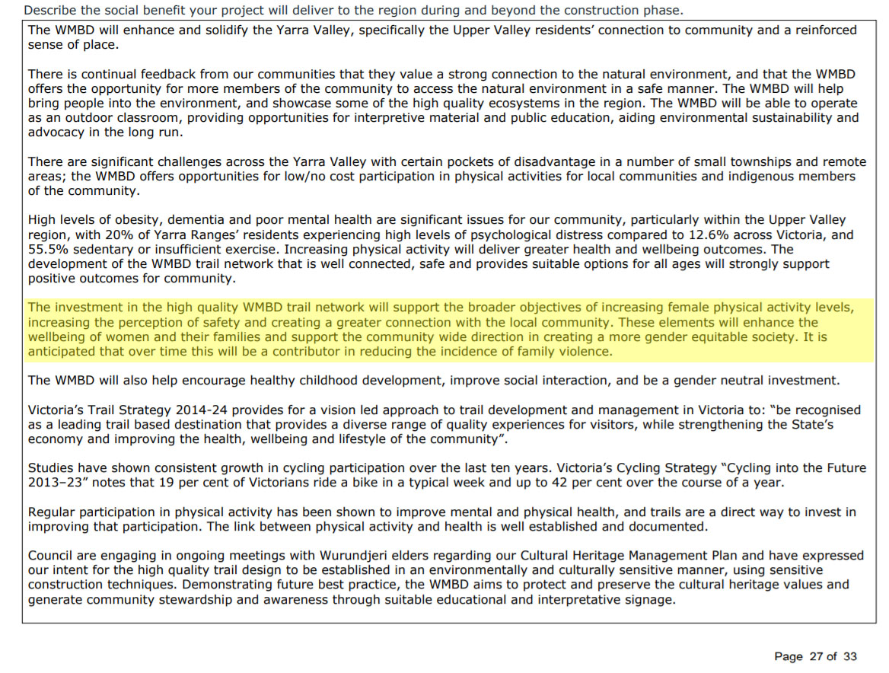

Slide 49
The Gender Impact Assessment
A Gender Impact Assessment is required before any major project can go ahead and The Warburton Mountain Bike Destination Project is preparing one. Many residents are concerned that this Assessment will not be accurate and that we will not be able to give input to it.
There is a certain amount of desperation to portray the Warburton Mountain Bike Project as a female sport. Is it?
Those in favour of the project say yes, it is, those against say no it is not.
The statistics clearly say: No, it is not.

Slide 50
Why are gender equity programs encouraging women to participate in male dominated sports? Is it really what women want or is it to rubber stamp male dominated sports as gender neutral?
What do women want?
Why don’t you ask them?
Instead of telling them.
And stop hiding behind “gender stereotyping” to dismiss women’s desired recreations

Slide 51
Locals prefer walking to riding a bike
Yarra Ranges Council installed six eco-counters on the Lilydale to Warburton Rail Trail. When Stage 3 COVID-19 restrictions were implemented the Rail Trail saw a 49% increase in use despite a 52% decrease in bicycle traffic compared to the same time the year before.
Trail use spikes – be a trail legend – Yarra Ranges Council – 22 October 2020

Slide 52
Age

Slide 53
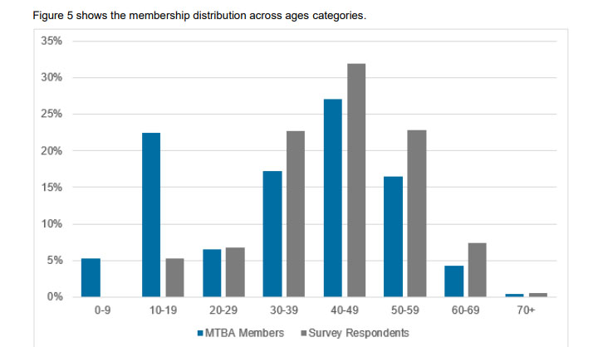
AusCycling Age Distribution of mountain bikers 2021

Slide 54
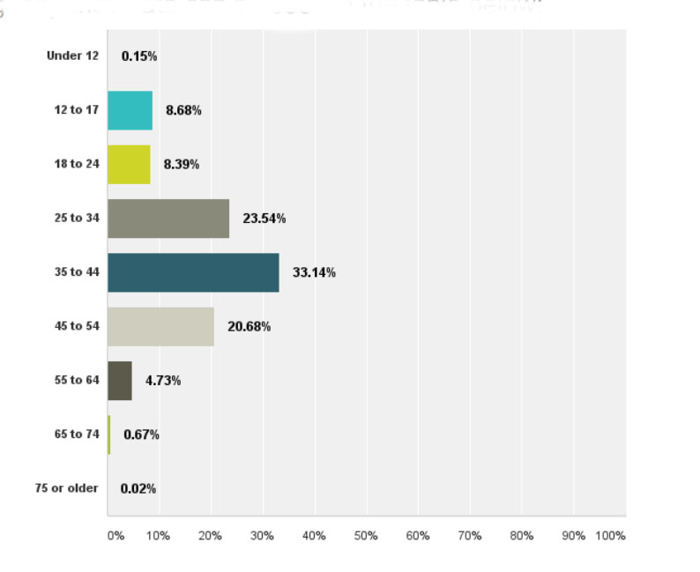
Mountain Bike Participation by Age Group:
Over 55 Age Group 5.42%
from a survey that analysed 2901 respondents
--Australian Mountain Bike Market Profile- Survey Data, DirtArt, 2016

Slide 55
How old are Warburtonites?
Warburton
49% are over 50 years old
40% are over 55 years old
51% are women
--Census Quickstats 2016 Australian Bureau of Statistics
Members of our major demographics are unlikely to take up mountain biking

Slide 56
What age group suffers from diabetes?
The Project says it will help prevent diabetes.
However, the prevalence of diabetes increases with age.
45-54 years 4.5%
55-64 years 10%
75 and over 19%
--Australian Institute of Health and Welfare
And if they are not taking up mountain biking how are you helping them?

Slide 57
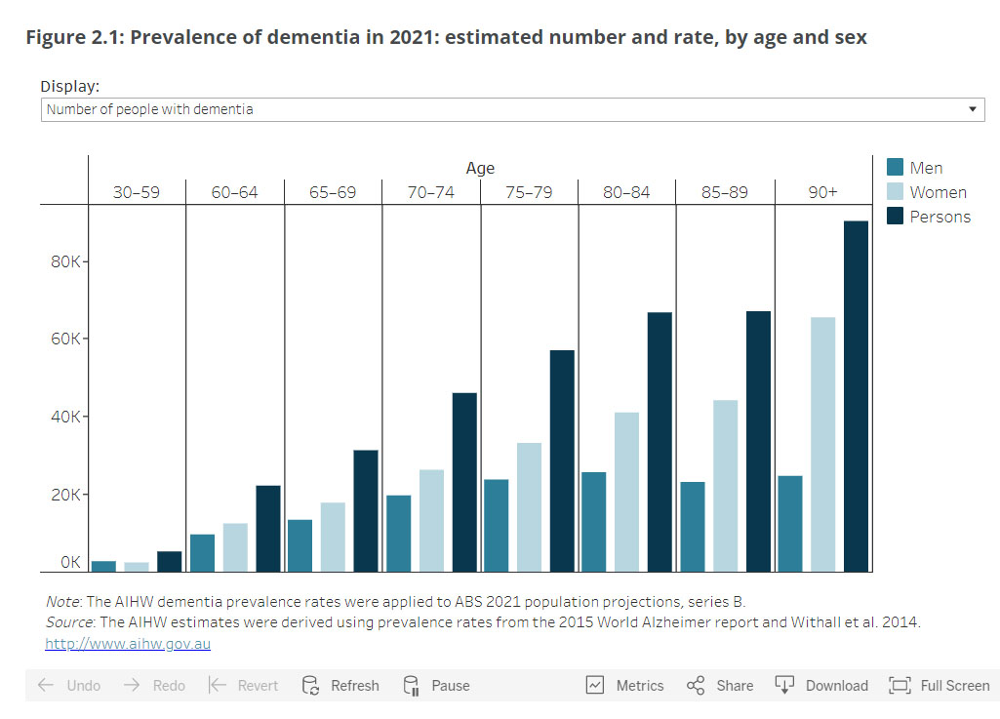
Dementia

Slide 58
What’s the most popular recreation for the older demographic?

Slide 59
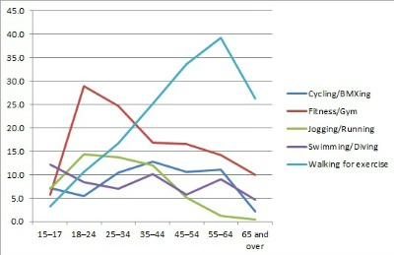
Most popular exercise:
Walking
over taking:
cycling at age 17 swimming at age 20
jogging/running at age 25
and gym at age 34.

Slide 60
No, the Warburton Mountain Bike Destination won’t help prevent dementia,
obesity or diabetes
It will make it worse

Slide 61
Roy Morgan Top 20 Sports
2019 and 2021
No. 1
Walking 51.9%
No. 6
Cycling 6.4%
No. 7
Bushwalking (during Covid)
5.2%
No 9
Golf 2.6%
No 18
Mountain Biking
1.4%

Slide 62
Walking is increasing in popularity
Roy Morgan Research - percentage of participation of the Australian population in walking:
2014/15: 44.4%
2017/18: 47%
2019/20: 48.1%
2020/21: 51.9%

Slide 63
Sports Injuries
Injuries, both the short term and long term health impacts, are a serious problem.
Sports Injuries: 5.2 million people per year
Permanent Injuries: 500,000 (close to 10%)
30-40% stop playing sport
Sports injuries represent 24% of all long term medical conditions
⁻ wear and tear injuries that affect bones, joints and internal organs and also have an accumulative effect.
National Health Survey: Injuries, Australia, 2001, Australian Bureau of Statistics, Catalogue Number 4384.0 (2001)

Slide 64
Economic cost of injuries
Sport injury costs the economy around
$2 billion a year
on a par with obesity, widely regarded as one of the nation's biggest public health challenges.
--Medibank Private
Injuries are a significant reason for dropout (i.e. non-participation in sport) each year, and this impacts upon lifelong physical activity habits.
--Time to add a new priority target for child injury prevention? - British Medical Journal Open - 20 July, 2014

Slide 65
Our young people . . .
Sport and recreation is the leading cause of injury in youth and may lead to:
lower levels of physical activity
higher adiposity
and long-term consequences such as:
overweight/obesity
post traumatic osteoarthritis
post-concussion syndrome
which can adversely affect future health.
--Injury prevention in kids’ adventure and extreme sports: future directions - Research in Sports Medicine - 15 April 2018

Slide 66
Post Concussive Syndrome, Brain Injury and Dementia
Mountain biking has a high head, neck and chest injury count ranging from 9% to 11.3% of all hospitalisations for mountain bike injuries.
A bad concussion in VCE can wipe out a students results for the entire year, due to problems with memory and concentration.
A severe TBI can become a lifelong sentence of being unable to live independently, needing intensive care. This type of injury will happen in the lifetime of the Warburton Mountain Bike Destination as will quadriplegia and paraplegia and deaths.
Mountain biking is not less dangerous than road biking
Statistics show that it has more injuries and just as many serious injuries

Slide 67
The Warburton Mountain Bike Destination claims it will save 41.7 million in health costs over ten years (based on studies that are mostly walking and has no mountain bike component).
However, as a high head and neck injury sport it only takes:
1 quadriplegic to cost the health system $9.5 million
1 severe TBI to cost the health system $4.5 million
Walking, on the other hand, has an extremely low injury rate. With 51% of the population, it is only 2.5% of injuries – the reason for the low injury rate fraudulently claimed by the Warburton Mountain Bike Destination Project.

Slide 68
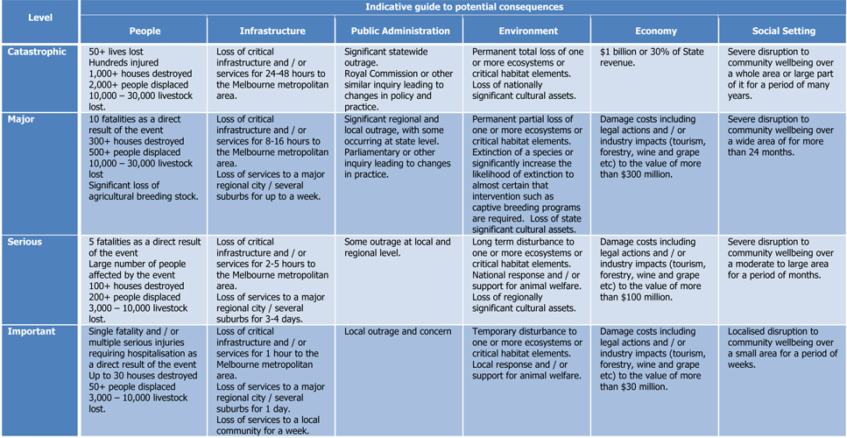
Warburton Mountain Bike Risk Assessment
The instructions in this table on how to report risk request that any likelihood of loss of life, injury or risk to infrastructure should be reported.

Slide 69
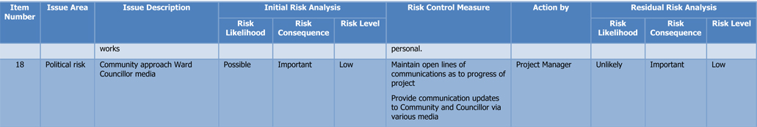
Everything was construction risks and Political Risk only
No mention of the possibility of loss of life or injury from mountain bike injuries.
No mention of loss of life or injury or damage to infrastructure from bushfire
Political risk:
Community approach Ward Councilor media . . . unlikely - Risk: low

Slide 70
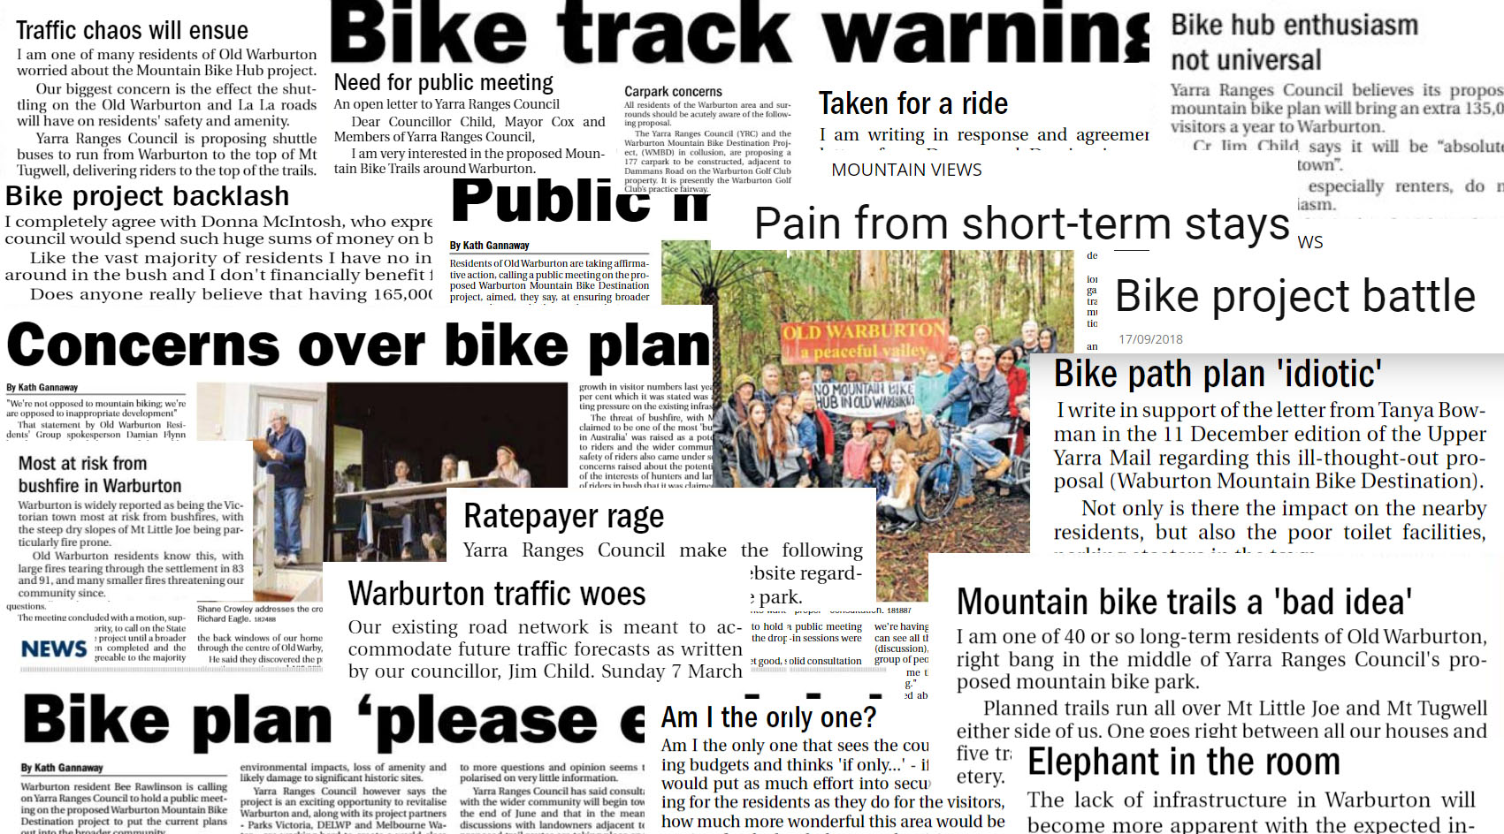

Slide 71
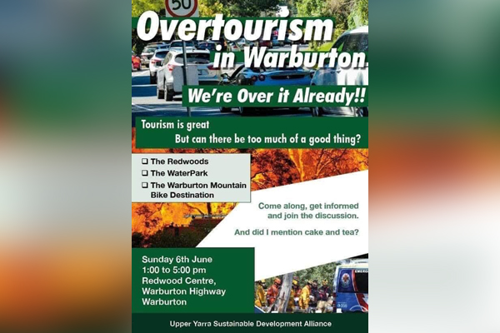
‘Over it already!’: Why Warburton locals are rallying against tourists - 3AW - 21 May 2021
Backlash over Victorian town’s fight against tourist influx - the Weekend Australian - 21 May 2021

Slide 72
Injuries from accidents or bushfire were not mentioned in:
The Warburton Mountain Bike Risk Management Plan 2016
Qualitative Risk Assessment December 2019
The health sections of the EES documentation 2021
Despite the criteria for risk assessment stating that anything that may result in death or injury should be included. More fraud.

Slide 73
"We will have champions"
Our sports stars are some of the unhealthiest people in Australia. They start out fit, they have muscular strength and incredible skill. However, injuries take a terrible toll on them.
Casey Brown is one of Mountain Biking’s top female athletes and this is what she has to say about her injuries:
“I’ve broken my pelvis, lost teeth, split open my liver, broken my ribs and collarbone, and have knocked myself out,” she says. “But injuries are just a part of the sport. When you’re going full speed down a mountain, you’re bound to slip up every once in a while.”
--https://www.shape.com/fitness/training-plans/casey-brown-mountain-biker-inspire-test-limits September 20, 2018

Slide 74
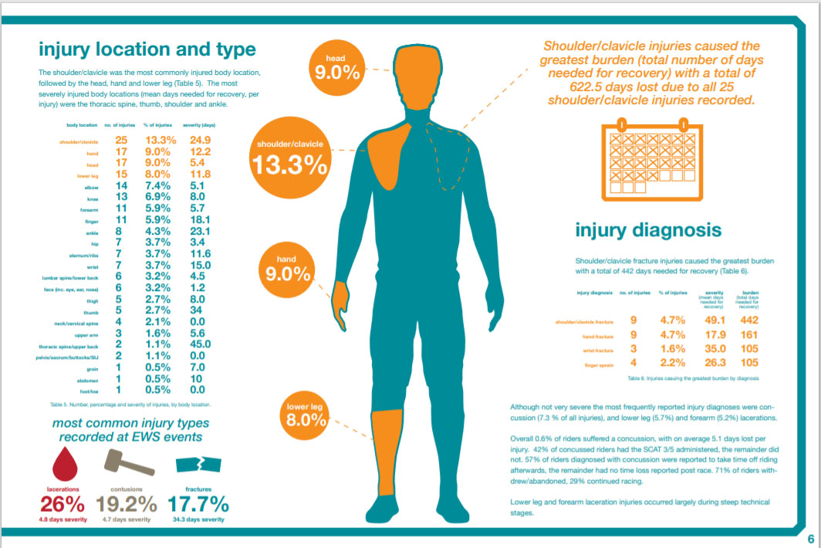
Enduro mountain bike medical study
Enduro World Series with Edinburgh Napier University, 2018

Slide 75
Brain Injuries
There are higher rates in athletes of a range of neurological problems including:
PCS - Post Concussive Syndrome
TBI - Traumatic Brain Injury
Epilepsy
Parkinsons disease
CTE - Chronic Traumatic Encephalopathy

Slide 76
Ambulance Costs
Ambulance approx: $1866 per trip
Helicopter trip: between $11,000 and $26,852
--NIB
“If required a helicopter can be used for emergency rider crashes which is located at Wesburn Park.”
--WMBD EES Technical Appendix D Land use and planning 8.1.1 Emergency service access Page 38
Yes, it will be required

Slide 77
"How common are deaths and other injuries? What causes those injuries and what can be done to prevent them? We don’t really know. Australia has no national, or even state-based, monitoring of sports injuries.”
--Better data reporting will prevent sports injuries and deaths
the Conversation
New Zealand:
Accident Compensation Corporation
2015/2016 7,731 claims for mountain bike injuries
The Accident Compensation scheme was developed because private insurers in New Zealand refused to cover Adventure Tourism injuries.
Australia doesn’t keep mountain bike injury statistics.

Slide 78
Cycling has more life-threatening injuries than football
Hospitalised injuries:
Number 1: football
Number 2: Cycling 12%. 6.4% of population participate
Walking: 2.5% 51% of population participate
Life threatening injuries:
Cycling 24%
--Hospitalised sports injury in Australia
Australian sports injury hospitalisations 2011-12

Slide 79
Whistler Mountain Bike Park 2012 study
772 hospitalisations:
442 Fractures
122 Clavicle fractures
109 Broken Wrists
1 in 7 suffered head trauma
Male 86% of injuries
Upper-extremity fractures 74.2% of all fractures
11.2% of all patients had traumatic brain injury

Slide 80
The economic cost of spinal cord and traumatic brain injury in Australia are estimated to be (in 2009):
The lifetime costs per incident case:
Moderate TBI: $2.5 million
Severe TBI: $4.8 million
The lifetime cost per incident case:
Paraplegia $5.0 million
Quadriplegia $9.5 million
--The economic cost of spinal cord injury and traumatic brain injury in Australia, Access Economics Pty Ltd for The Victorian Neurotrauma Initiative, 2009

Slide 81
Strain on emergency services
“Referring to the overstretched services in the Yarra Valley, Mobile Intensive Care Paramedic Jason Callanan says:
Your brother who is short of breath having an asthma attack, we can’t get to him in time because we’re dealing with this (an avoidable car crash). To another. “Your baby sister who has croup, we can’t get to her in time,” and another, “Your mum or dad who has chest pain, or could be having a stroke, we can’t get to them either, because we’re dealing with this; and it’s something that could have been avoided.”
https://mountainviews.mailcommunity.com.au/mail/2018-08-13/trip-the-ambos-story/

Slide 82
In the WMBD EES Technical Appendix E Socio-economic 10.7.1 Page 53
“There are some concerns that injuries sustained at the Warburton Mountain Bike Destination will stretch the resources of the region’s hospital system. RMCG has not been able to uncover direct evidence about hospitalisation rates from mountain biking injuries. However, it can be inferred from other mountain bike parks that this concern will not eventuate. Other mountain bike parks (Bright, Derby, Forrest) are located in much smaller hospital systems than that in which the project is located. RMCG has not encountered any evidence of hospital systems from these areas being stretched by mountain biking injuries.”
They weren’t looking very hard . . .

Slide 83
Tasmanian mountain bike industry shifting hospitals’ focus - The Examiner - January 10 2020
“The state’s emergency departments have also experienced a spike in presentations related to mountain bike trauma, with an increase in the number and severity of injuries presenting to the Launceston General, Scottsdale and St Helens hospitals.”

Slide 84
Time off work - loss of productivity
“Research suggests that between 2012 and 2017:
over 2 million people had to take some time off work due to a sporting injury
half a million were forced to take unpaid time off
178,000 had to leave the workforce entirely"
https://www.finder.com.au/sports-injuries-in-australia

Slide 85
Men are five times more likely to have TBI and SCI than women are.
So why are we encouraging women to engage in high head injury sports? Men should be changing to women’s recreations not the other way around

Slide 86
Neurodegenerative disease in athletes
Over half of brains donated to the Australian Sports Brain Bank have signs of chronic traumatic encephalopathy (CTE), a degenerative brain disease associated with repeated blows to the head, researchers have found.
Data from the first three years of the national brain bank shows that of the first 21 donors — all of whom participated in sports with risks of repetitive head injury — all but one donor had some form of neurodegeneration, including 12 who were found to have CTE
CTE, which can only be diagnosed post-mortem, is associated with behavioural, mental and cognitive impairments, including memory loss, personality changes and depression. Symptoms typically appear years or even decades after brain injury is sustained.
The researchers found three of the brain donors with CTE were under the age of 35, and six of the 12 donors with CTE had died by suicide.
--Neurodegeneration linked to repetitive head injury found in brains of former Australian sports players, ABC News, Mon 28 Feb 2022

Slide 87
CTE - Chronic Traumatic Encephalopathy
Only recently discovered, CTE can only be diagnosed on autopsy. It causes micro damage in the brain. However, checking for CTE is not a regular part of an autopsy, so the family has to donate the brain to a brain bank.
This means many cases of CTE are incorrectly diagnosed as dementia.
So is mountain biking really going to prevent dementia as claimed?
No it is not

Slide 88
A third of children experience mental health issues after concussion, research finds
A review of the literature looking at more than 90,000 children who were concussed found children take twice as long to recover from concussion than adults, with one in four children experiencing symptoms beyond one month post-injury.
The research found 36.7 per cent of children who are concussed experience internalised mental health problems, such as anxiety, depression, and post-traumatic stress.
It also found 20 per cent had externalising problems such as aggression, attention problems and hyperactivity.
ABC News, 30 Apr 2021
Note that aggression is a common side effect of brain injury – so how is mountain biking going to decrease family violence if it is a high brain injury sport?

Slide 89
The suicides of two former NFL stars prompted more than 4,500 former players to sue the NFL after it emerged that the players had suffered from the concussion-related injury Chronic Traumatic Encephalopathy (CTE).
While the lawsuit was rejected by a judge, studies of NFL players with long-term health effects showed their propensity to suffer from neurodegenerative diseases such as Alzheimers or Parkinsons at three times the rate of the average person. Could the same be occurring in cycling without anyone realising?
In January 2011, the UCI seemed ahead of the game when it ratified the Zurich Consensus Statement 2008, relating to concussion protocols, and provided WorldTour teams with its ‘Recommendations of the UCI on Concussion’.

Slide 90
Recent News items mountain bike deaths
Victorian rider dies on Tasmania's Maydena mountain-bike trail - ABC News - 12 Mar 2022
A 29-year-old Victorian man, described as an experienced rider, has died after a crash at a popular Tasmanian mountain-biking trail.
St Helens mountain bike rider dies after crash on popular Tasmanian trail - ABC News - 30 Oct 2021
Around 4:15pm on Friday, an ambulance was called to the St Helens mountain bike trail head on Flagstaff Road after reports a 67-year-old man had suffered a serious crash during a technical descent.

Slide 91
Are Cyclists suffering CTE
As a largely undiagnosed condition, we don’t know unless a cyclists donate their brain to a CTE brain bank.
However:
The champion BMX rider, Dave Mirren, who committed suicide at the age of 42 because of CTE is the first cyclist to be diagnosed.
Suicide is a common cause of death for those suffering CTE as the brain damage is so debilitating, they take their own lives.
Australia's first female Olympic cyclist Julie Speight donating brain for medical research due to persistent neurological difficulties
Youngest person to die from it was 17 years old

Slide 92
For the past six years, Fraga, who runs the website the Knockout Project, has suffered from PCS, or post concussion syndrome, the result of concussions while racing BMX. The symptoms of PCS are similar to those who had CTE.
In a video he posted to his Facebook page after Mirra’s diagnosis, Fraga said he doesn’t like giving live interviews because he has a tough time keeping his train of thought (his interview for the Guardian was conducted via Facebook Messenger).
“A good day feels like you’re not quite hungover, but probably overdid it a little the night before,” Fraga wrote. “The bad days are like hell on earth … You go with the ebb and flow between those two extremes while also dealing with vision problems, balance issues, depression, mood swings, memory lapses, etc. Some of those things seem to get better. But then they come roaring back out of nowhere and you’re left with the realization that you might always be like this.
“I go back and forth between wanting to know and not wanting to know (if he has CTE). I already feel lousy; what’s it going to do to my emotional state to confirm the worst-case scenario?”

Slide 93
The Mountain Bikers are not the only ones that will get injured
Pedestrians are asking for a TAC style compensation scheme to pay for injuries from collisions
They are also requesting removing shared paths from busy areas
Pedestrians are fighting for compensation after run-ins with cyclists 7NEWS 05.10.2021
We are having accidents, near misses and general discomfort for our walkers on our RailTrail.
The Project predicts that we will have a more than three fold increase of bike traffic on the RailTrail due to mountain bikers using it when the Warburton Mountain Bike Destination is built.

Slide 94
Vulnerable demographics
The Marsden Jacobs report used by Council also states:
We also know that the physical activity of Victorians and Australians generally declines with age, and that females of all ages generally have lower physical activity rates than males (VicHealth, 2016).
Mountain biking is a male dominated sport. It is also rarely taken up by people over fifty.

